Slide 1


Class starts @ 11am sharp
Problem Solving & Programming
Concepts
Week 4 - Class
Please ensure your microphone is muted but working at the start of class. Video is Optional.
To test your microphone, do a test before you get started by using: https://www.onlinemictest.com/
Notes:
Make learning an adventure

Slide 2
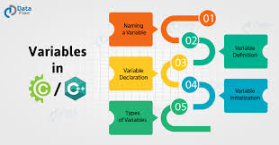
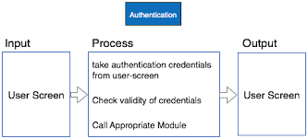
Variables & IPO
Week 4

Slide 3


Attendance
Please note your attendance will be recorded throughout this class
Notes:
Make learning an adventure

Slide 4

Quizizz Time
A series of 10 questions will be asked!
Notes:
Make learning an adventure

Slide 5
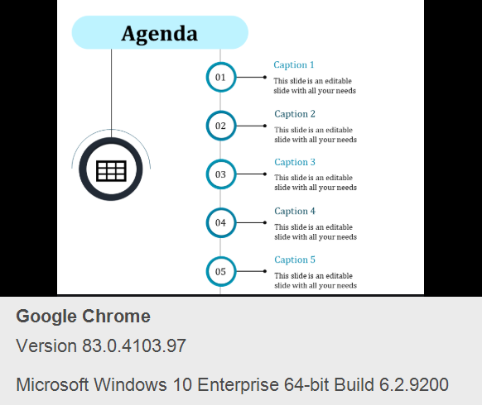
Agenda
AGENDA
01
What is a variable?
02
Datatypes
03
Naming Conventions
04
Operators and Expressions
05
IPO Chart

Slide 6


Data Storage – How a computer stores data
The computer stores data internally in memory locations
These data are found by the computer by their variable names
Each variable name is allocated a location and each location can hold only one value at a time
When you put a new value in a variable, the previous value is destroyed
These memory locations are temporary such that when a program ends, the values are destroyed
N
Progress Bar
What is a
variable?
Naming
Conventions
Exercise
1
Types of
Data
Exercise
2
Operators
Expressions &
Equations
Exercise
3
BREAK
IPO
How to
create a IPO
Exercise
4

Slide 7
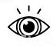
N
What is a variable?
You must tell me what sort of data you want to save!
The valuable of a variable may change during the processing of instructions
In computing terms, a variables name is the label a computer uses to find the correct memory location and the variables value is the contents of the memory location
Data
I am a variable!
I can store your data. Please give me a name so that the computer can find me
variable

Slide 8

N
Constant
A constant is a value – that is, a specific alphabetical and/or numeric value that never changes during the processing of all of the instructions in a solution.
Q
In the chat window, provide some examples of constants
Data
CONSTANT
Notes:
Example: Cost of a ticket, Pie, or a mathematical formula

Slide 9
N
So to REMEMBER!
A data item is a variable when its value can be changed while a program is running.
A data item is constant when its value can’t be changed while a program is running.
Progress Bar
✓
What is a
variable?
Naming
Conventions
Exercise
1
Types of
Data
Exercise
2
Operators
Expressions &
Equations
Exercise
3
BREAK
IPO
How to
create a IPO
Exercise
4

Slide 10
N
Naming Conventions for Constants & Variables
Naming conventions vary from one programming language to another but the following rules apply in most if not all cases.
Name a variable according to what it represents, keeping it as short as possible
Example:
Be consistent in the use of variable names, you cannot refer to one variable by more than one name
Start a variable name with a letter, never a number
nameOfPerson2
nameOfPerson
Do not use spaces in a variable name. Use camelCase or underscore instead. Start with a lower case letter. Every new word after that gets a capital letter
Do not use a dash (or any other symbol that is used as a mathematical operator) in a variable name
Name constants using all upper case letters
DOGNAME
petName

Slide 11


E
xercise 1: Naming Conventions
10 mins
E
In the teams Notebook, outline what is wrong with these variable names? Write down the correct way to write the variable name?
City Name referencing the name of a city
Client-name referencing a client name
City/State referencing a city and state
LN referencing a last name
Street address
Q for a quantity of books
Street_Address_for_Joe’s_Hardware_Supply_Incorporated_Client
Teams
Notebook
Progress Bar
✓
✓
What is a
variable?
Naming
Conventions
Exercise
1
Types of
Data
Exercise
2
Operators
Expressions &
Equations
Exercise
3
BREAK
IPO
How to
create a IPO
Exercise
4

Slide 12




N
Types of Data – Numbers and words
The computer can store different types of data including:
String
Numeric
All whole and decimal numbers
Character
All individual letters, numbers and special symbols
String Combinations of more than one character
Boolean True or False (Valid or invalid)
Whole numbers or Integers – 1,2,3,4,5,6,7,8 or decimals 0.1,0.2,0.3
Denoted by single quotation marks ‘ ’
Denoted by double quotation marks “”

Slide 13
E
xercise 2: Knowing your Datatype
10 mins
E
Name the data type for each of the following
Data | Datatype
5.38
“87654”
True
“707-434-555”
“New York”
-389
2.45E6
48976.0
False
Q
When asked, pop your answers in via the chat window
Progress Bar
✓
✓
✓
✓
What is a
variable?
Naming
Conventions
Exercise
1
Types of
Data
Exercise
2
Operators
Expressions &
Equations
Exercise
3
BREAK
IPO
How to
create a IPO
Exercise
4

Slide 14
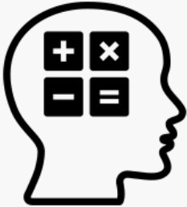
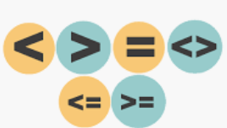
N
Operators
1
Mathematical – addition,
subtraction, multiplication etc.
Computers have to be told how to process data
To do this we use operators
They tell the computer what type of processing needs to be done
2
Relational – equal to, less than,
greater than etc.
3
Logical – relational expressions to perform operations on logical data
Progress Bar
✓
✓
✓
✓
✓
What is a
variable?
Naming
Conventions
Exercise
1
Types of
Data
Exercise
2
Operators
Expressions &
Equations
Exercise
3
BREAK
IPO
How to
create a IPO
Exercise
4

Slide 15
N
Operators & Computer Symbols
Mathematical
Operator | Computer Symbol | Example
Addition | + | 3.0 + 5.2
Subtraction | - | 7.5 - 4.0
Multiplication | * | 8.0 * 5.0
Division | / | 9.0 / 4.0
Modulo division | % | 9 % 4
Power | ˄ | 3 ˄ 2
Relational
Operator | Computer Symbol | Example
Equal to | = | 5 = 5
Less than | < | 5 < 7
Greater than | > | 7 > 5
Less than or equal to | < = | 5 < = 7
Greater than or equal to | > = | 7 > = 5
Not equal to | ! = | 5 != 7
Logical
Operator | Computer Symbol | Example
Not | NOT | NOT True
And | AND | True AND True
Or | OR | True OR False
Q
In the chat window, what would be the answer to this:
9%4?
Notes:
* Return to logical operators when it is covered in Maths

Slide 16

N
Strings (Text) and the role of the + operator
When you want to join words together, you can use the + operator.
So for example, if you want to print out hello followed by the name typed in by a user, it would look something like this:
“Hello” + name;
Progress Bar
✓
✓
✓
✓
✓
✓
What is a
variable?
Naming
Conventions
Exercise
1
Types of
Data
Exercise
2
Operators
Expressions &
Equations
Exercise
3
BREAK
IPO
How to
create a IPO
Exercise
4

Slide 17

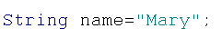
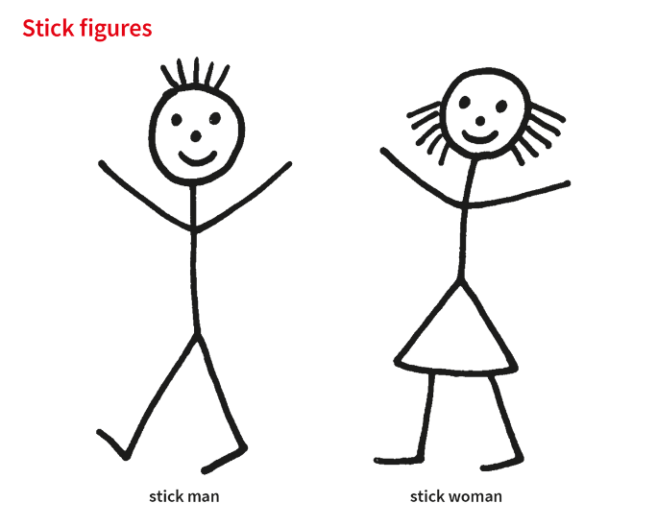
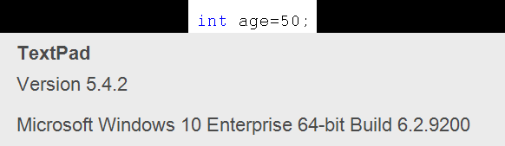
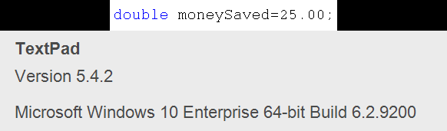
N
Looking at one Programming language
If we were to look at Java Programming, how would we save data having looked at variables, data types and naming conventions?
This is John, he is 50 years of age and has saved 25.00 in his bank account. Lets use two variables to save this data
This is Mary, lets save her name using Java Programming
Datatype
Assign
Variable Name
What you want to store

Slide 18
N
Looking at one Programming language
Datatypes in Java Programming
Example: We want to store 20 euros in a variable, what do we do? (We assume money is always a double)
Data we want to store | Datatype | Datatype in Java
30.50 | Decimal | double
25 years | Integer | int
John | Text | String
C | Character | char
Step 1: Create/Declare a variable
int money;
Step 2: Initialise/Assign a variable
money=20.00;
OR
Declare and Initialise in one line
int money=20.00;
We give the variable a name so that we can refer to it again
Name of variable
money
20.00
Value stored

Slide 19
N
Expressions and Equations
When working out an calculation, it looks a little bit different to how we would normally write it
In an equation such as this, Length and Width are known as Operands and Area is referred to as the resultant
Equation
Expression
Area = Length * Width

Slide 20

E
xercise 3: Fill in the missing blanks
5 mins
E
In five minutes, I will randomly pick 5 individual people to provide the answers via the chat window
1
customerName=“Sam”;
2
number1=234;
4
String patientName
“Ann”;
5
totalAmount=54.00;
Progress Bar
✓
✓
✓
✓
✓
✓
✓
What is a
variable?
Naming
Conventions
Exercise
1
Types of
Data
Exercise
2
Operators
Expressions &
Equations
Exercise
3
BREAK
IPO
How to
create a IPO
Exercise
4

Slide 21

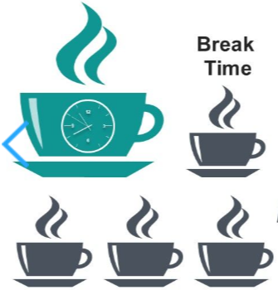
T
Check Chat window for return time
TEA BREAK FOR 10 MINUTES

Slide 22
Q
Anyone know what IPO stands for?
Enter your answers via the chat window

Slide 23
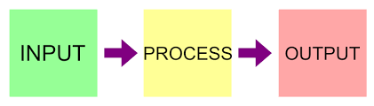
IPO Chart
[Input Process and Output]
Progress Bar
✓
✓
✓
✓
✓
✓
✓
✓
✓
What is a
variable?
Naming
Conventions
Exercise
1
Types of
Data
Exercise
2
Operators
Expressions &
Equations
Exercise
3
BREAK
IPO
How to
create a IPO
Exercise
4

Slide 24

N
What is a IPO Chart?
Input Process Output (IPO) diagrams or charts are used to visually display the inputs, processes and expected outputs of a application
Input
Data that is entered into the system either from a user or obtained from another location in the application
Process
A series of steps/operations that will be applied to the input data in order to convert it into the desired output
Output
Data that has been turned into information after processing.

Slide 25
N
IPO Chart
Input | Processing | Output
What does the user have to input
What do we need to send back to the user?
What calculations do we have to work out
TIP: Always start with the Output, then the Input followed lastly by the processing!

Slide 26
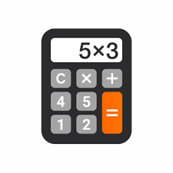
N
Lets look at an example!
A program is to be developed that allows a user to enter in two different numbers.
The software should add the numbers together and output the total result.
The IPO diagram below outlines the layout of the elements:
Example: Basic Calculator
Input | Process | Output
number1 number2 | Assign variable for number1 Assign variable for number2 Calculate number1 and number2 | Display calculation result
Progress Bar
✓
✓
✓
✓
✓
✓
✓
✓
✓
✓
What is a
variable?
Naming
Conventions
Exercise
1
Types of
Data
Exercise
2
Operators
Expressions &
Equations
Exercise
3
BREAK
IPO
How to
create a IPO
Exercise
4

Slide 27

E
xercise 4: IPO Diagrams
20 mins
E
Log into Moodle and open up Exercise 4
and follow the instructions!
Progress Bar
✓
✓
✓
✓
✓
✓
✓
✓
✓
✓
✓
What is a
variable?
Naming
Conventions
Exercise
1
Types of
Data
Exercise
2
Operators
Expressions &
Equations
Exercise
3
BREAK
IPO
How to
create a IPO
Exercise
4

Slide 28
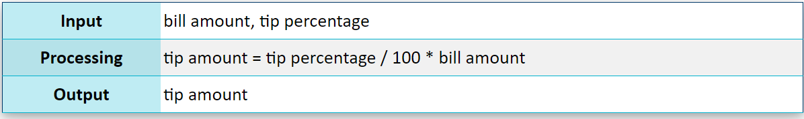
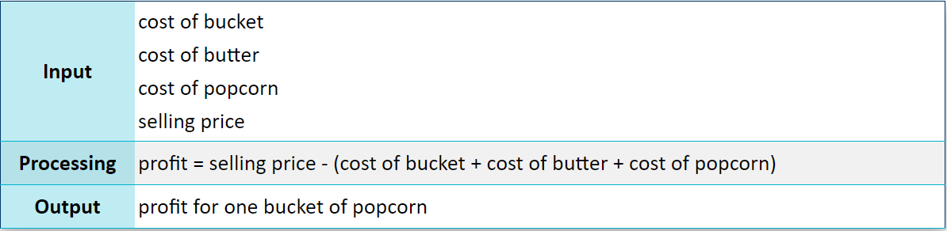
xercise 4: ANSWERS
E
TIP CALCULATOR
MOVIE THEATRE

Slide 29
Attendance
Attendance will now be downloaded
Notes:
Make learning an adventure

Slide 30

A variable can change whereby a constant cannot change
String stores text
int stores whole numbers (1,2,3)
double stores decimals (1.1,1.2)
IPO stands for Input, Processing and output
Progress Bar
✓
✓
✓
✓
✓
✓
✓
✓
✓
✓
✓
✓
What is a
variable?
Naming
Conventions
Exercise
1
Types of
Data
Exercise
2
Operators
Expressions &
Equations
Exercise
3
BREAK
IPO
How to
create a IPO
Exercise
4

